Slide 1


System Integration P3 AUTIN – Third Prty System

Slide 2
Background
Is needed to send CM status every time it change

Slide 3
Phase 1: Connecting Systems (Outbound)

Slide 4
Logic integration

Slide 5
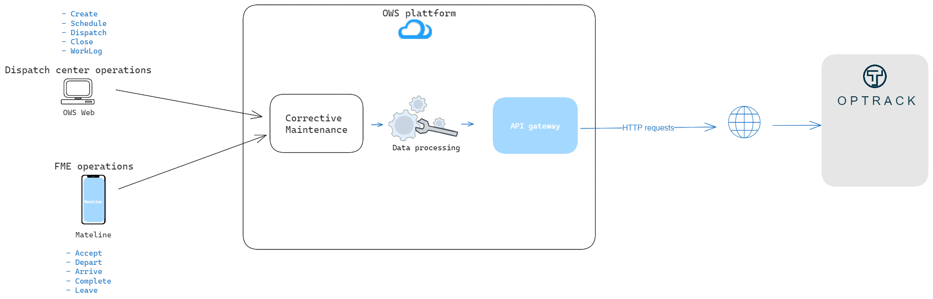
Send status through API

Slide 6
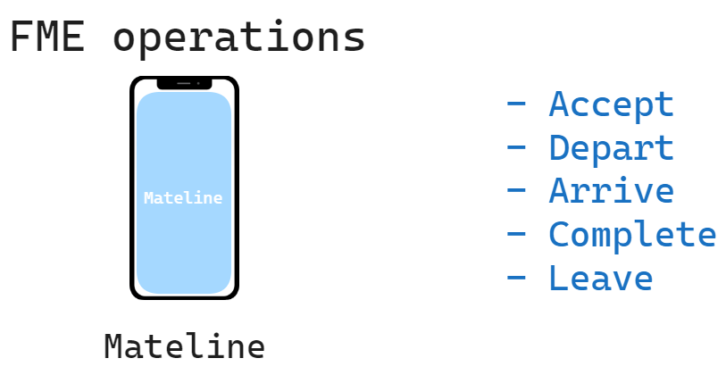
Mateline operations (FME)
Every time the FME processes the task
The current operation Will be send to Optrack
And modify the description of Optrack ticket

Slide 7
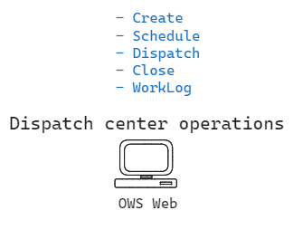
Dispatcher operations
Every time the Dispatch center processes a CM
OWS send the description of the action to optrack and modify the ticket in Optrack

Slide 8
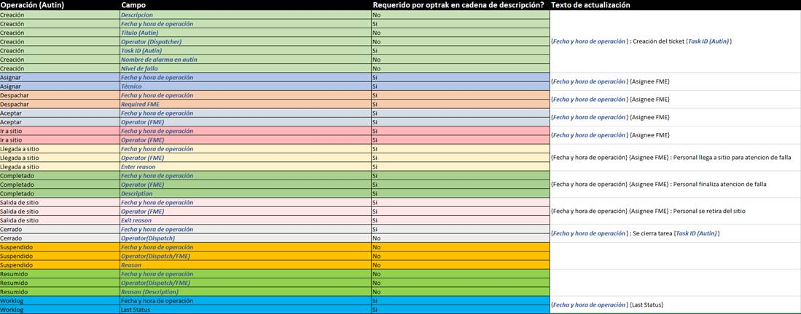
Operation messages

Slide 9
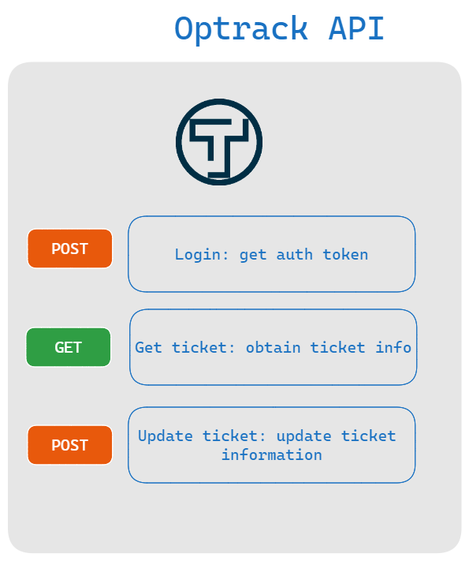
Optrack API
Every request must be made with Authorization via tokens, every token expires after 10 hours of generation

Slide 10
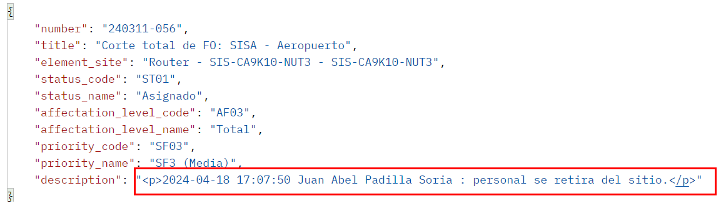
Example of update

Slide 11
Phase 2: Manual updates (Outbound)

Slide 12
Background
Is needed to send custom messages to third party system

Slide 13
PC page

Slide 14
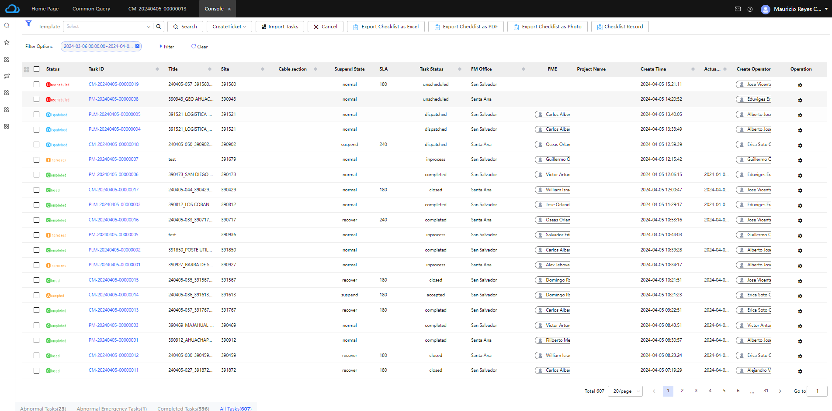
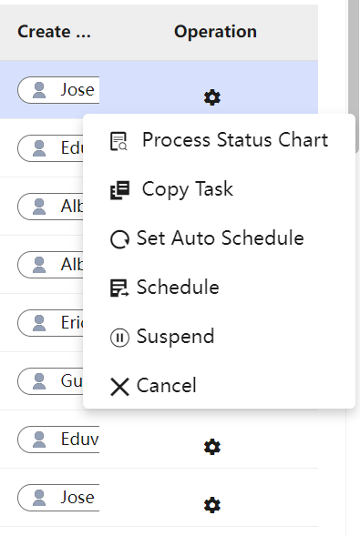
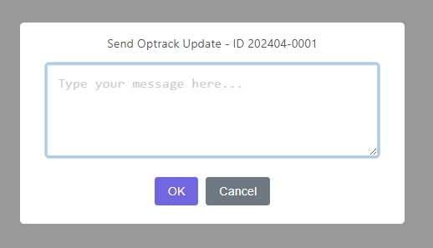
Record advances in CM
Modify console:
Add new option to send optrack updates
Last Status

Slide 15
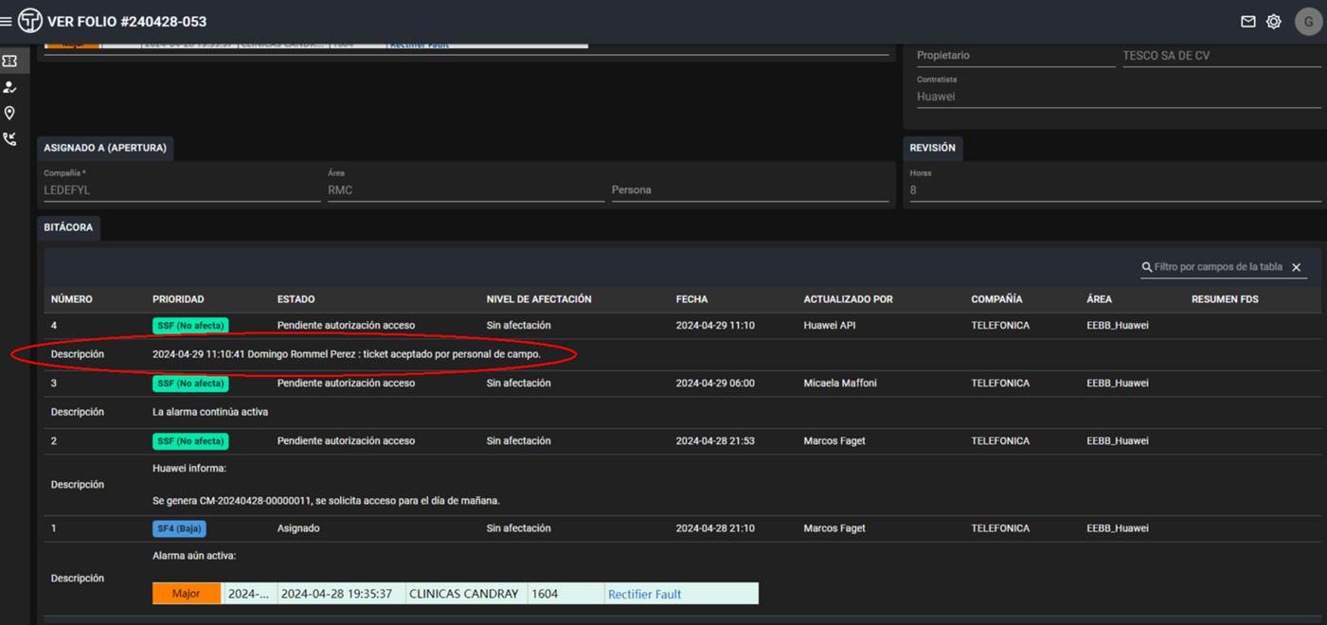

Record advances (send to otprack)
OWS

Slide 16
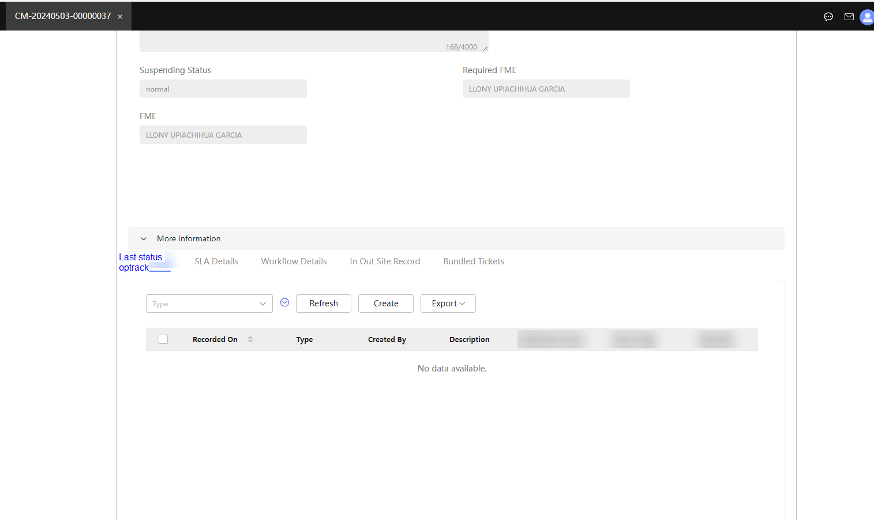
Record advances (log)
Every status sent to optrack Will appear in each CM Work Order

Slide 17
Phase 3: Receiving system updates (Inbound)

Slide 18
Background
Is needed to receive request from Third Party System to create CM tickets in OWS

Slide 19
Send WO information through API
Huawei will provide the endpoints:
- Create WO
- Query WO
- Update

Slide 20
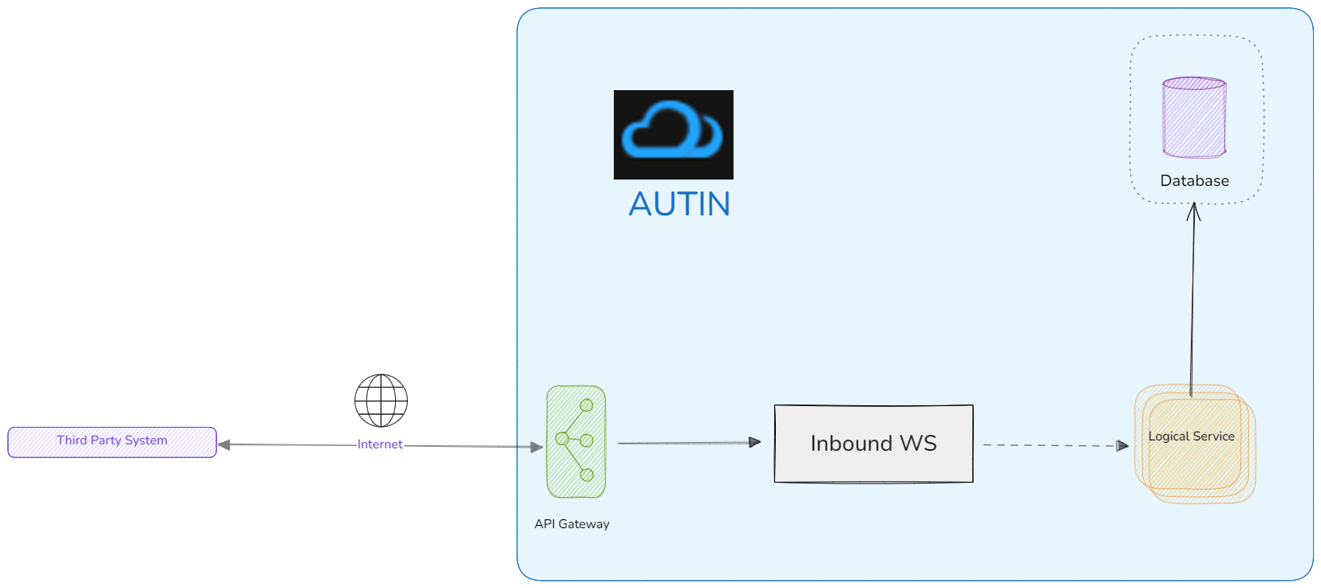

OWS CM API
Every request must be done with Basic Auth (user and password will be defined).

Slide 21
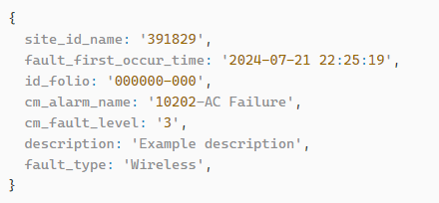

Example of create

Slide 22
Example of update

Slide 23
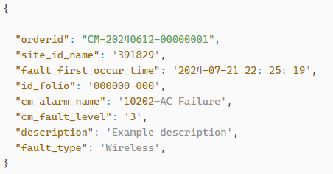

Example of query

Slide 24
Work plan
Phase | Description | Total days
Phase 1 | Analisys | 1
Phase 1 | Outbound integral testing and analysis | 0.5
Phase 1 | Authentication Outbound REST creation | 1
Phase 1 | Authentication Outbound REST test | 0.5
Phase 1 | Query ticket Outbound REST creation | 1
Phase 1 | Query ticket Outbound REST test | 0.5
Phase 1 | Update ticket Outbound REST creation | 1
Phase 1 | Update ticket Outbound REST test | 1
Phase 1 | Get token interface service codification AUTIN | 1
Phase 1 | Query ticket interface service codification AUTIN | 1
Phase 1 | Update ticket interface service codification AUTIN | 1
Phase 1 | Logic integration after triggering AUTIN actions | 1.5
Phase 1 | Trigger configuration | 1
Phase 2 | Record last status advances record feature | 1
Phase 2 | Rest Outbound configuration | 1
Phase 2 | CM last status log record page | 1
Phase 3 | Coding create CM logic | 1
Phase 3 | Coding query CM logic | 1
Phase 3 | Coding update CM logic | 1
Phase 3 | Develop Inbound REST for create | 1
Phase 3 | Develop Inbount REST for query | 1
Phase 3 | Develop Inbount REST for update | 1
Phase 3 | Test | 2
Phase 3 | Production deploy | 2
Phase 3 | Documentation | 1
 | Total | 26

Slide 25



Copyright©2014 Huawei Technologies Co., Ltd. All Rights Reserved.
The information in this document may contain predictive statements including, without limitation, statements regarding the future financial and operating results, future product portfolio, new technology, etc. There are a number of factors that could cause actual results and developments to differ materially from those expressed or implied in the predictive statements. Therefore, such information is provided for reference purpose only and constitutes neither an offer nor an acceptance. Huawei may change the information at any time without notice.

